Slide 1

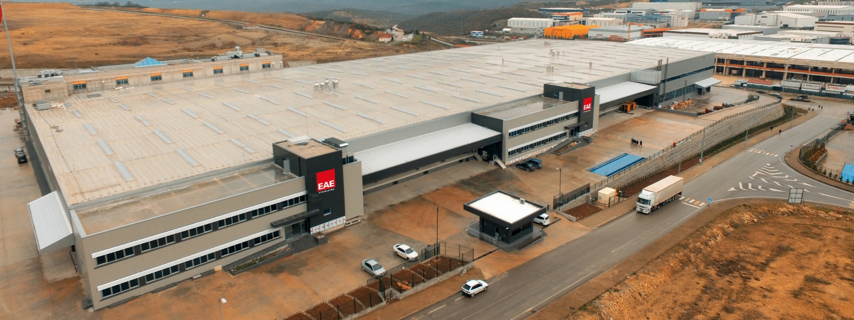
EAE Lighting
ENGINEERING THE LIGHT
Energy Saving Solutions

Slide 2






EAE Group
EAE ELEKTRIK Power Distribution Systems
EAE LIGHTING Energy Saving and Smart Lighting Solutions
EAE ELEKTROTEKNIK LV Enclosures & Type Tested Panels
EAE TEKNOLOJI KINEXA Building Management System
EAE MAKINA Flat Steel Press Automation Systems and Roll Form Systems
EAE ITALIA Energy Saving, Smart Lighting & Power Distribution Solutions
EAE RUSSIA Energy Saving, Smart Lighting & Power Distribution Solutions

Slide 3
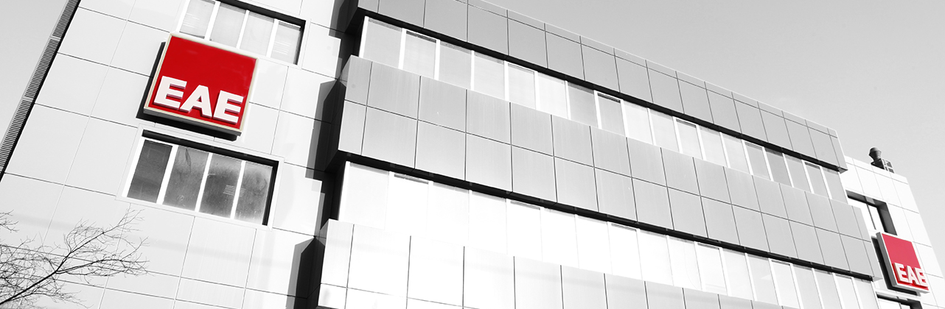
EAE Group
Group Date of Establishment – 1973
EAE Lighting Date of Establishment - 1983
Total 2500 Employees, 500 Engineers and Experts
5 Factories in Istanbul, Turkiye
Sister Company in Milano, EAE s.r.l Italia
1 Factory in Moscow, Russia
HEAD OFFICE
Ikitelli Organize Sanayi Bolgesi Ziya Gokalp Mahallesi
Eski Turgut Ozal Caddesi No: 20 34490 Başakşehir Istanbul / TURKIYE
Phone +90 (212) 413 21 00
Fax +90 (212) 549 37 90
Web www.eaeaydinlatma.com

Slide 4
Manufacturing Capabilities & Sales Volume
New plant : Gebze/Kocaeli in operation since September 2017
Manufacturing area : 65.000 m²
Annual capability : 6.000.000 luminaires of various types
Man power : 400 employees, 60 engineers and technical experts

Slide 5
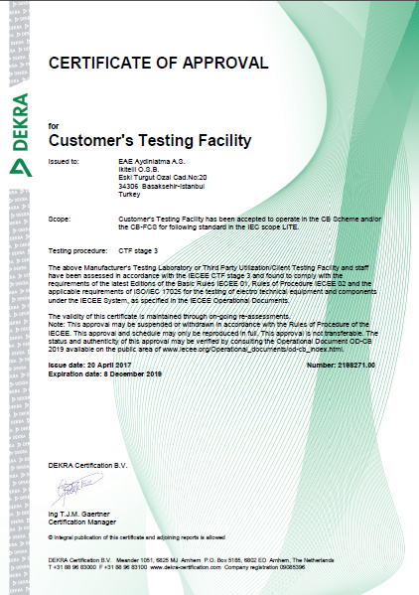
Quality Certificates

Slide 6
Quality Certificates

Slide 7
Global Sales Network
EUROPE
Austria, Belgium, Belarus, Bulgaria, Croatia, Czech Republic, France, Finland, Germany,
Great Britain, Hungary, Italy, Macedonia, Netherland, Romania, Serbia, Slovenia, Slovakia,
Spain, Sweden, Switzerland, Ukraine
AFRICA
Algeria, Egypt, Ethiopia, Ghana, Libia, Mauritius, Morocco, Sudan
ASIA
Armenia, Azerbaijan, Bangladesh, Georgia, Jordan, Iran, Iraq, Israel, Kazakhstan, Kuwait,
Lebanon, Maldives, Oman, Pakistan, Qatar, Russia, Saudi Arabia, Singapore, Turkmenistan,
United Arab Emirates, Uzbekistan
AUSTRALIA & NEW ZEALAND

Slide 8
Why EAE ?
Long Experience in Lighting
&
Extensive Product Range
EAE Group Power
to offer package solution Busbar/Cable Trays + Lighting + LightingControl
High Quality High quality and well known components manufacturers
Flexibility in design and cutomized production
Own production of all product types
Availability of large components stock
Big investment in R&D New product development center
Comply with EU Standards Laboratory, Production and Products
Large Testing Capability DEKRA Accredited Laboratory
Free Project Service Project design and lighting calculation

Slide 9

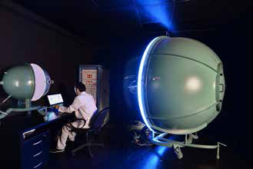

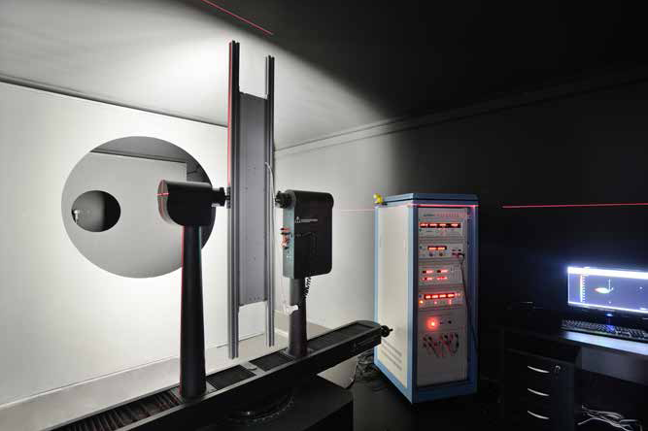

R&D and Laboratory
All products are type tested in our laboratory accredited by DEKRA, in accordance with IEC EN 60598-1 Standards.
Thermal testing
Corrosion testing
Electrical testing
Performance testing
Mechanical testing
Photometric measurements

Slide 10
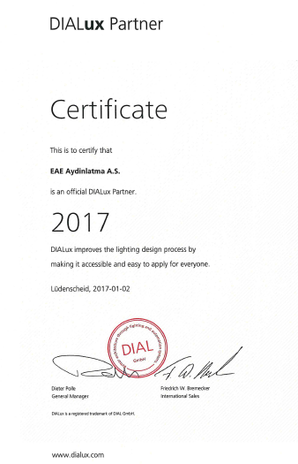


DIALux Partner
LIGHTING LUMINAIRES
Luminaire design
Professional lighting design and projects&quotes
Lighting calculations according to rules of LEED & BREAM
KNX AUTOMATION SYSTEMS
Free project services
Supervision and activation services
DL - DALI LIGHTING BUSBAR APPLICATIONS
Free project services

Slide 11
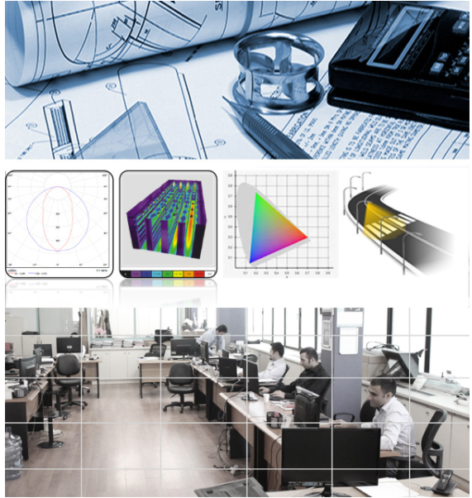

Project Department
Engineers, Architects and Technicians are studying lighting designs, calculation and payback time of the solution.
18 people
600 Projects each month
Free project services

Slide 12
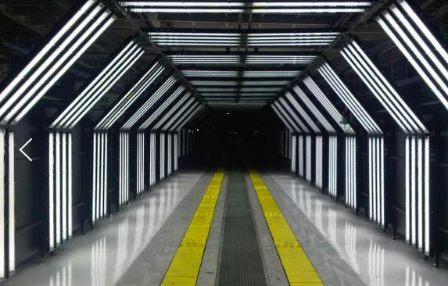
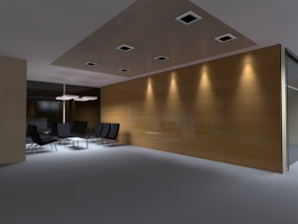
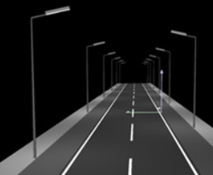
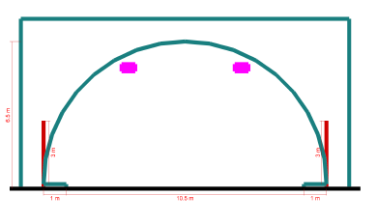
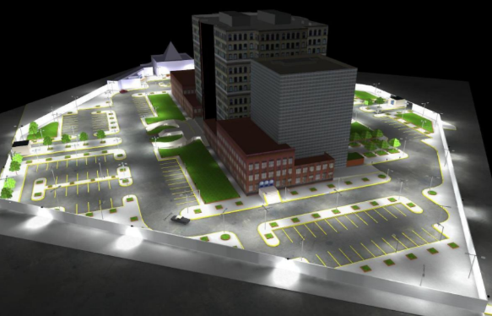
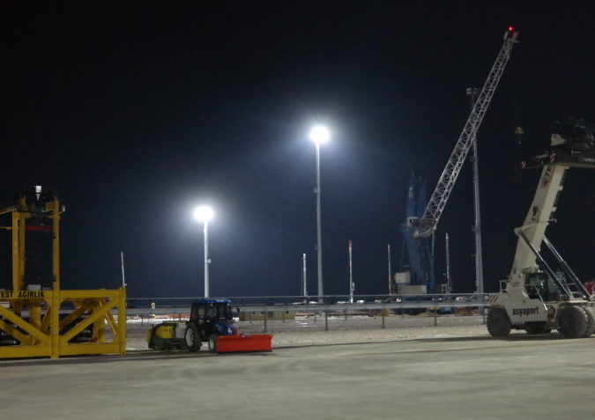
Sectors
Industrial and Architectural Interior Lighting
Outdoor Lighting
Sports Field Lighting
Street Lighting
Tunnel Lighting
Automotive Lighting
Port Lighting
Automation Systems.
Facade Lighting
LIGHTING CALCULATIONS ACCORDING TO RULES OF LEED & BREAM.

Slide 13
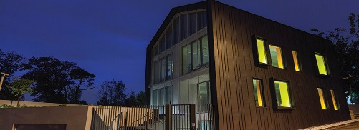
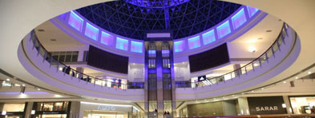
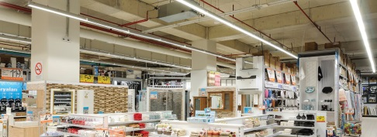
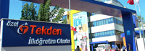
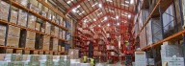
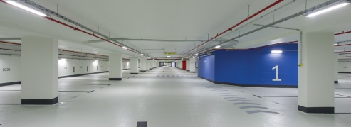
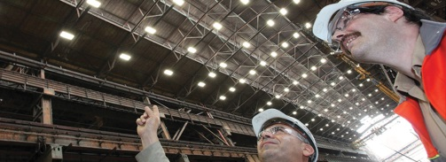
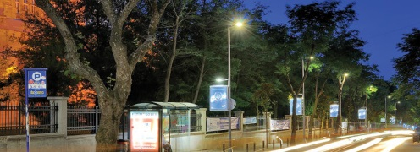
EAE Lighting Scope / Sectors
OFFICE & ADMINISTRATIVE STRUCTURE
SHOPPING MALLS
RETAIL
EDUCATIONAL BUILDINGS
LOGISTICS
CAR PARKS
INDUSTRIAL PRODUCTION
FACILITIES
OUTDOOR LIGHTING

Slide 14
Products
INDUSTRIAL LIGHTING LUMINAIRES

Slide 15
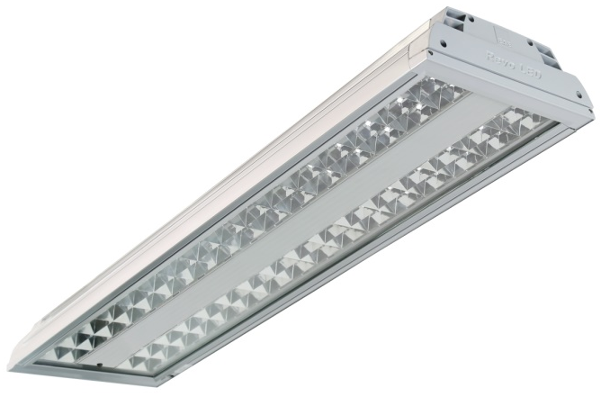
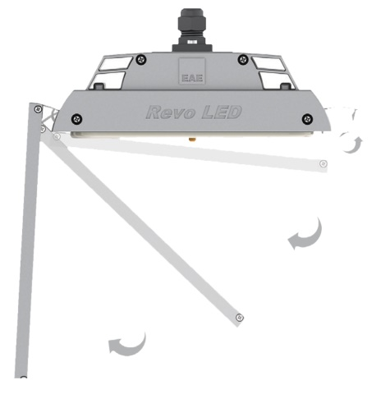
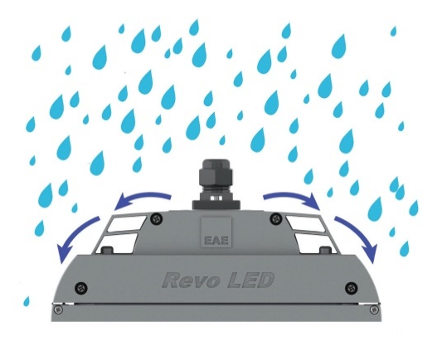
Products
REVOLED-S V.3 INDUSTRY
WORKING TEMPERATURE RANGE
-40 °C/+60 ° C
Housing | : | Aluminium Profile
Diffuser | : | Tempered Glass With Safety Film
Light Source | : | SMD LED
Power | : | 39W/74W/112W/137W
Input Voltage | : | 220-240V AC 50/60 Hz
Colour Temperature | : | Warm White / Natural White / Cool White
CRI | : | >80
IP | : | IP 65
Installation | : | Surface-Mounted
Colours | : | RAL 9006

Slide 16
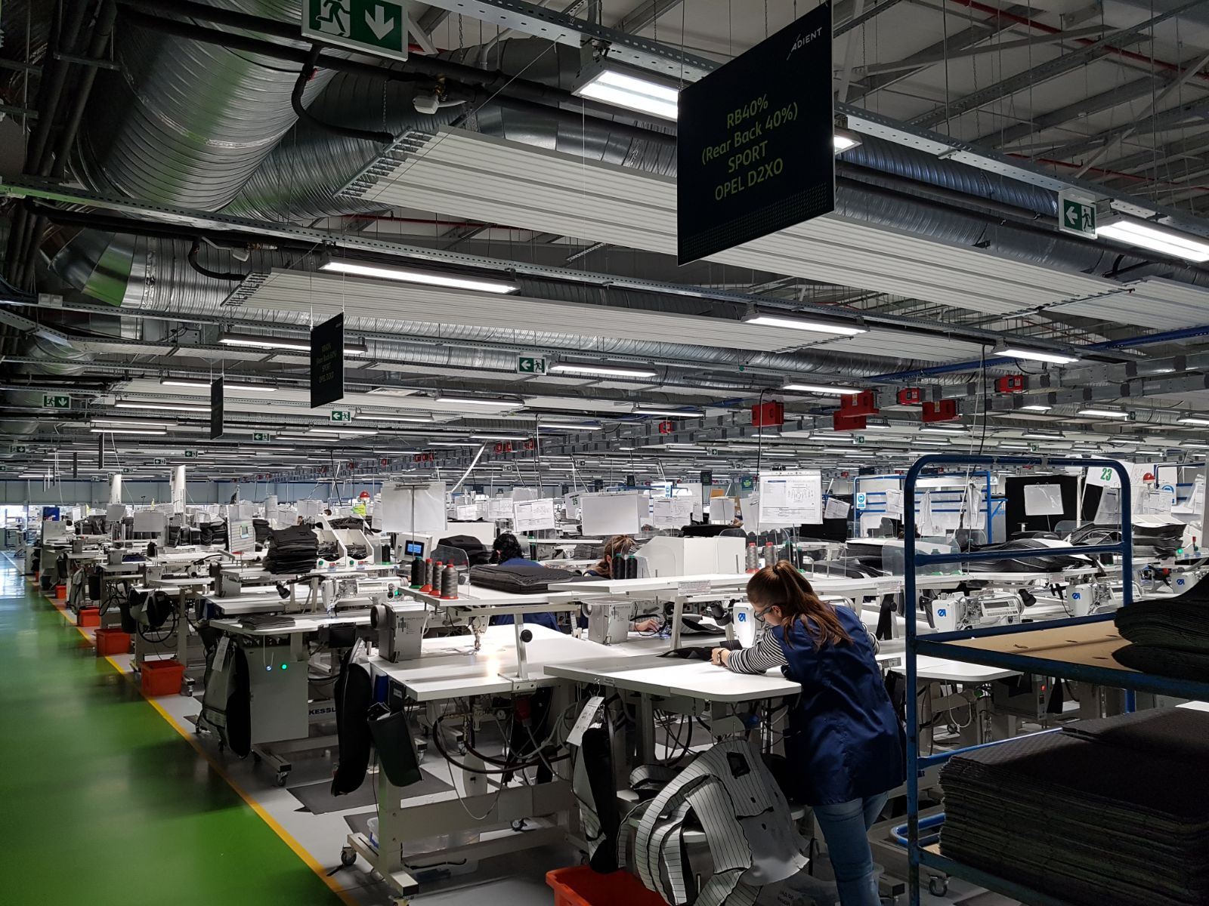
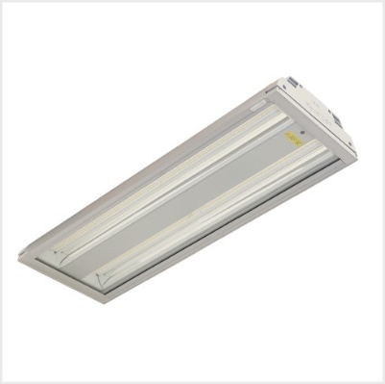
References
New project 2017
ADIENT (Johnson Control ) Strumica MACEDONIA
REVOLED S
Production Area

Slide 17
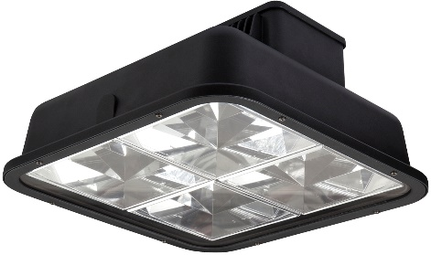
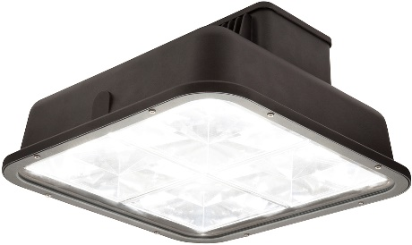
WORKING TEMPERATURE RANGE
-35 °C/+75 ° C
Products
SROUND V.2 INDUSTRY One Point Pendant High-Bay LED Luminaire
Housing : Aluminium Profile
Optical : Narrow angle-Wide angle miro silver reflector
Diffuser :Tempered transparent glass
Light Source : Mid Power LED / Power LED
Power : 56 W / 68 W / 76 W / 88 W / 136 W
Input Voltage :220-240V AC
Colour Temperature : Warm White / Natural White / Cool White
CRI : >80
IP : IP65-IP 66
Installation : Surface-Mounted / pendant
Colours : RAL 9006

Slide 18
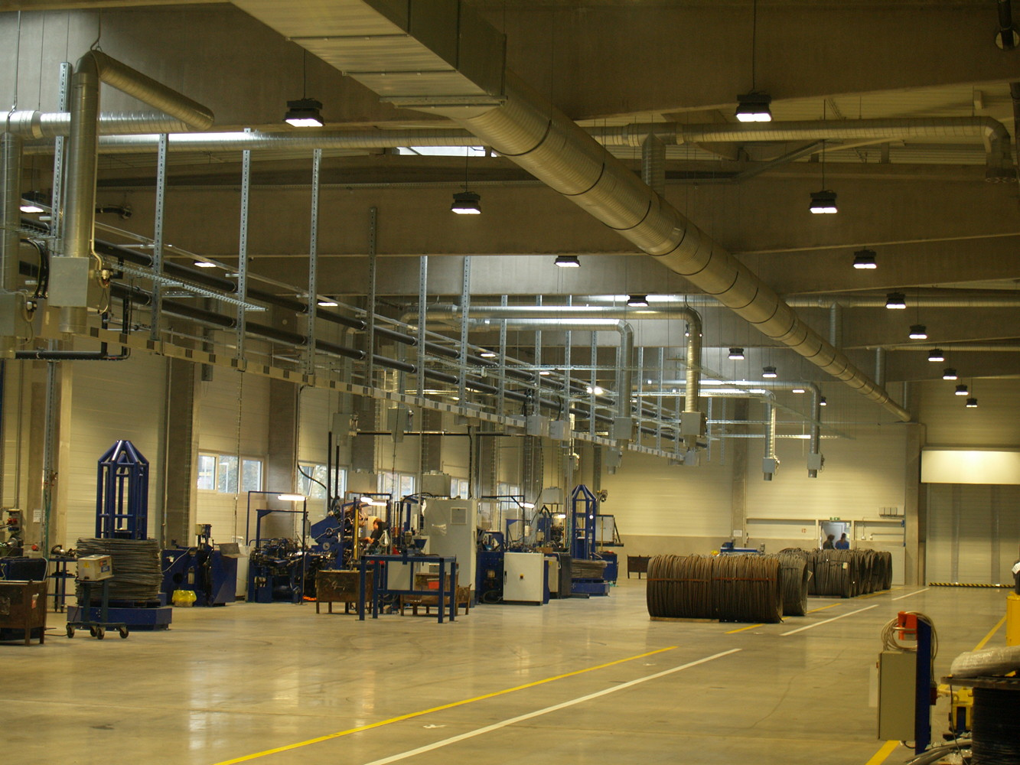
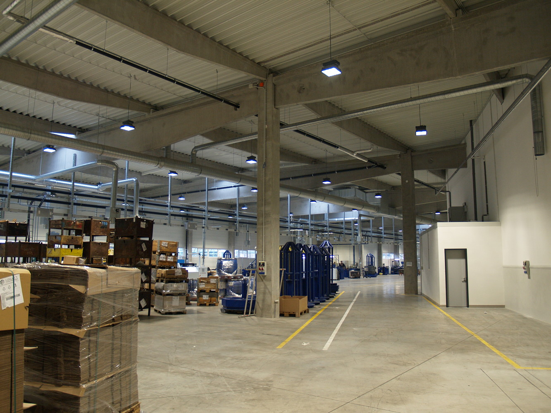
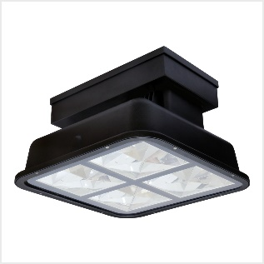
References
New project 2017
PEWAG Czech, s.r.o., Vamberk CZECH REPUBLIC
S ROUND
Production Area
Sround 137W With Industrial Driver

Slide 19
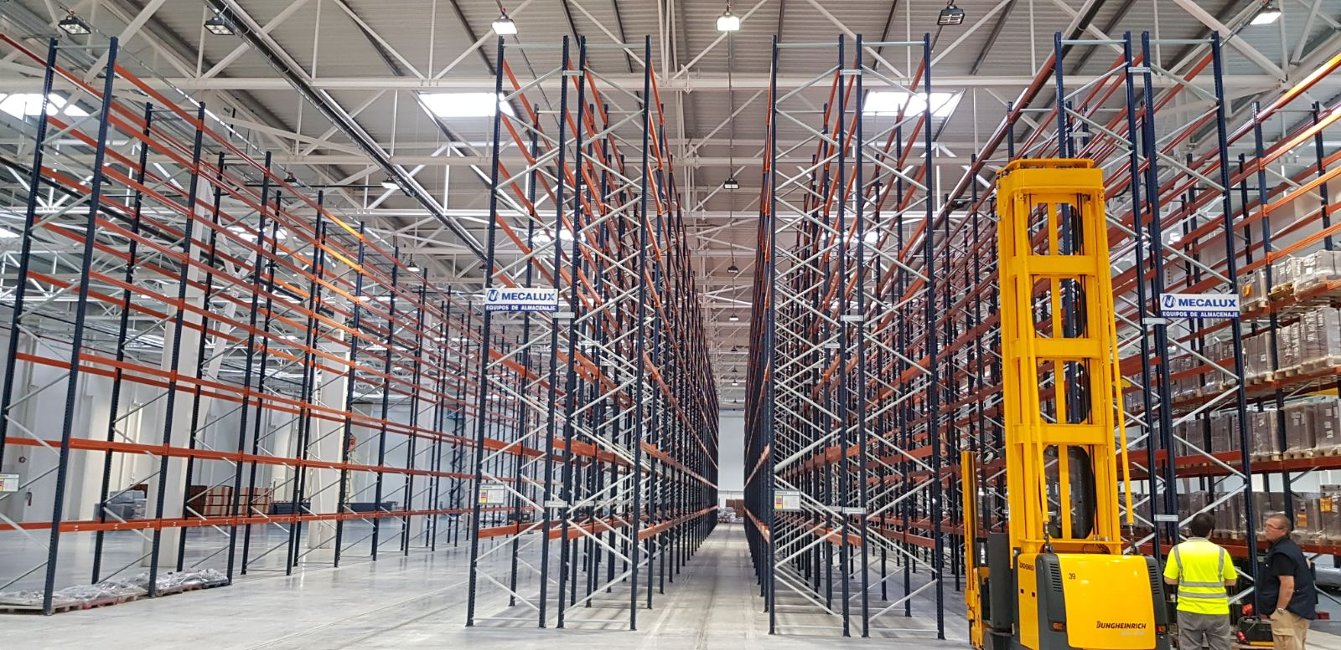
References
New project 2018
POWER ELECTRONICS Valencia SPAIN
S ROUND
Production Area
Sround 132W Dali

Slide 20
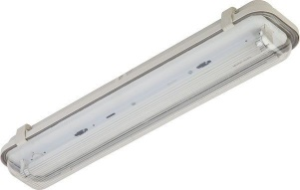
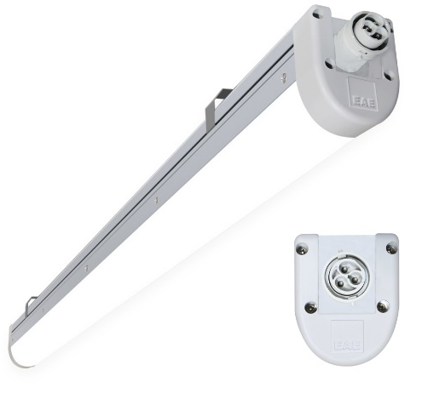

Products
LINA ETANJ V.3 Linear LED lighting luminaire
Housing :Aluminium extrusion housing
Diffuser :Glare controlled opal diffuser
Light Source : Mid Power LED
Power : 10 W / 19 W / 23 W / 31 W / 38 W / 56 W / 72 W
Lumen : 951 / 2191 / 2860 /3956 / 4.824 /7.276 / 9074
Input Voltage :220-240V AC
Colour Temperature : Warm white / Natural white / Cold white
CRI : >80
IP : IP64
Installation : Surface mounted
Colours : Anodize aluminium
SUBSTITUTES
20W 36W FLOURESCENT
30W 58W FLOURESCENT
40W 2*36W FLOURESCENT
45W 2*58W FLOURESCENT
60
ENERGY %
SAVING

Slide 21
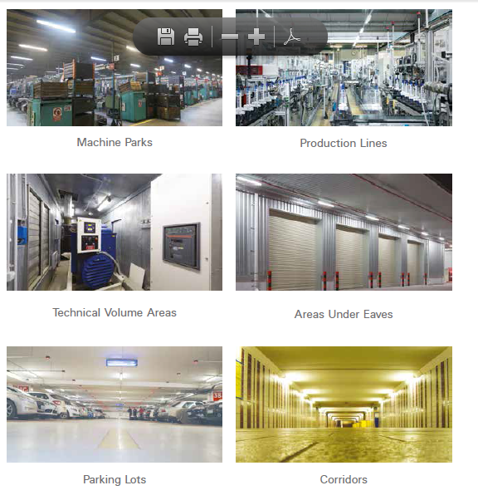
LINA ETANJ V3 – AREAS OF USE

Slide 22
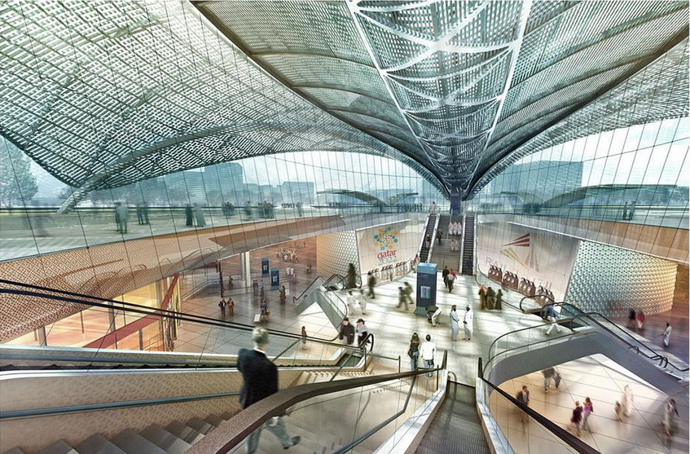
Projects
Metro
Green Line Metro – Doha Qatar

Slide 23
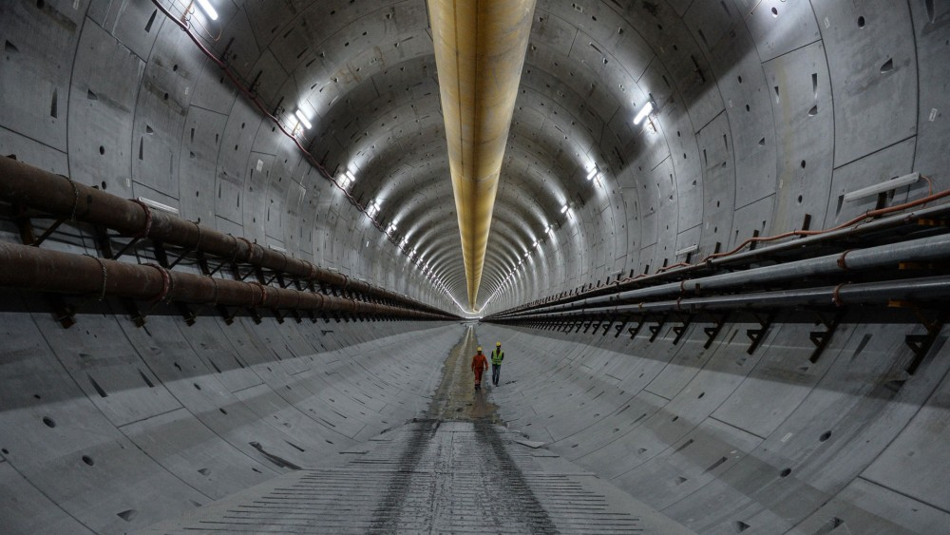
Projects
Metro
Avrasya Tunnel

Slide 24
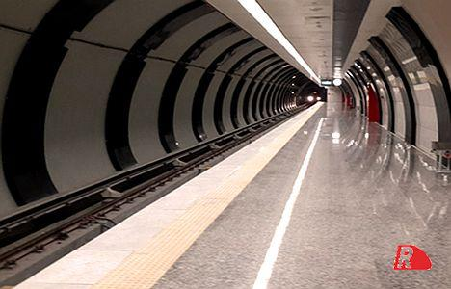
Projects
Metro
Aksaray -Yenikapı Metro

Slide 25
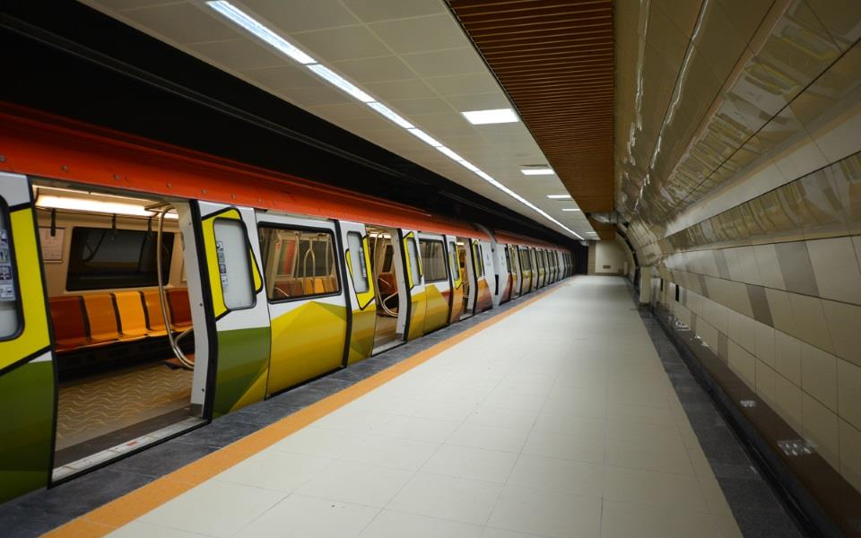
Projects
Metro
Kartal-Kaynarca Metro

Slide 26


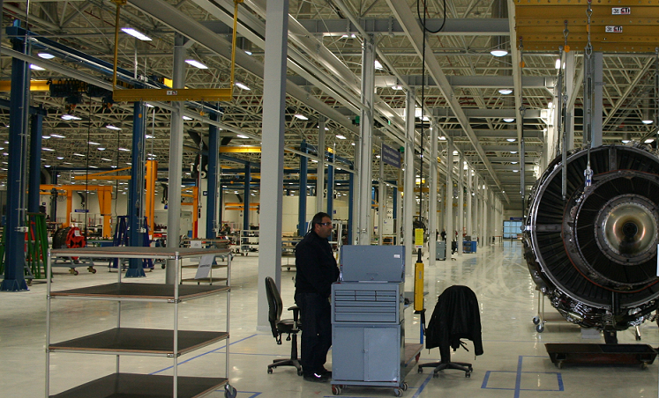
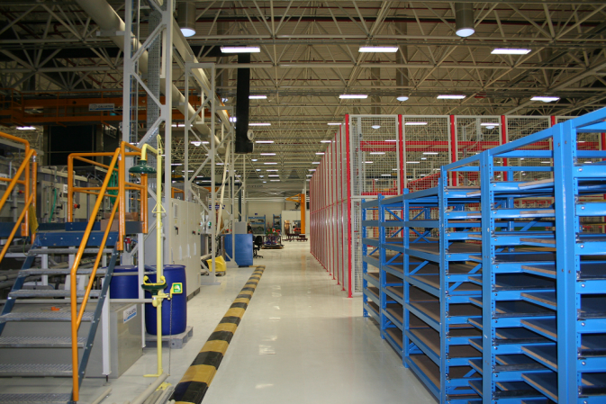
Projects
Aviation
Pratt & Whitney THY Technic Airplane Engine Maintenance Center

Slide 27
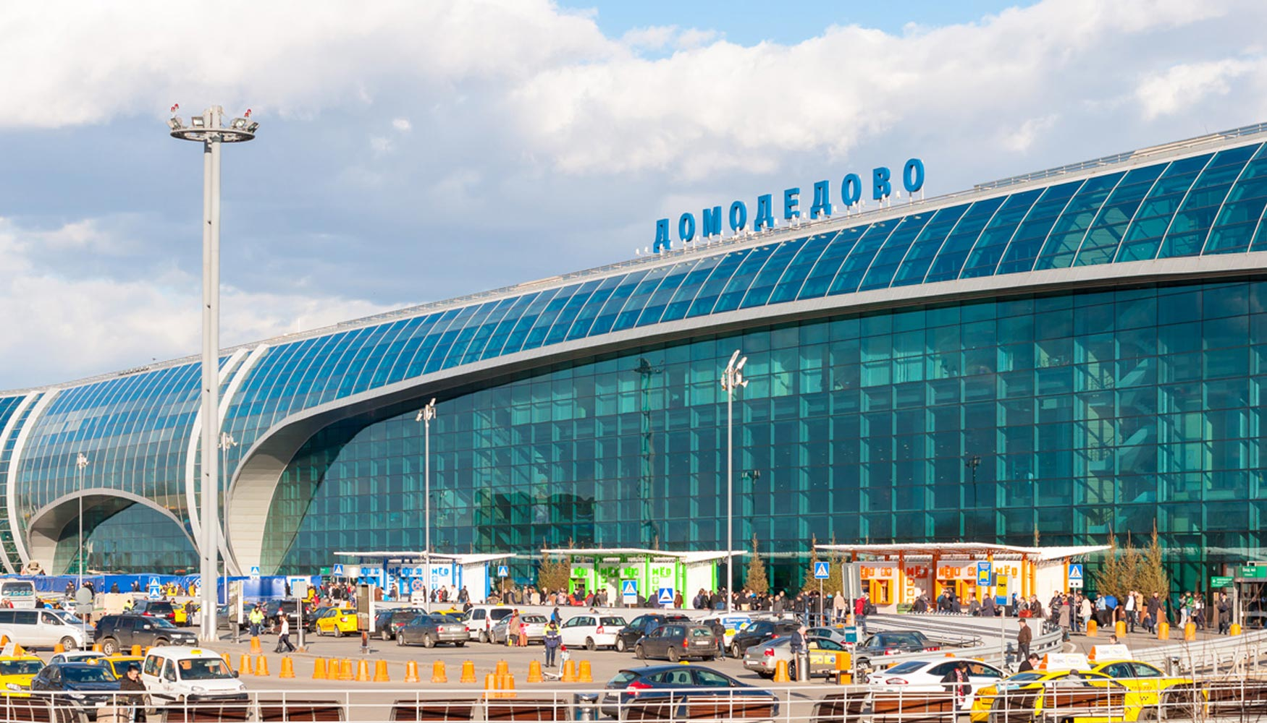
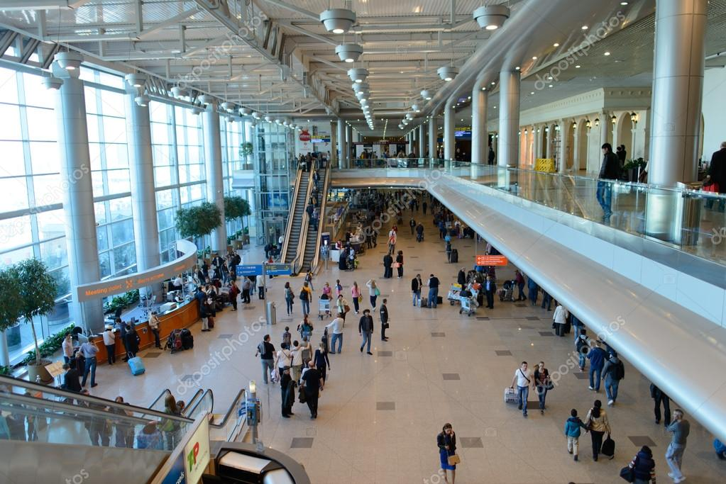
Projects
Aviation
Domodedovo International Airport

Slide 28
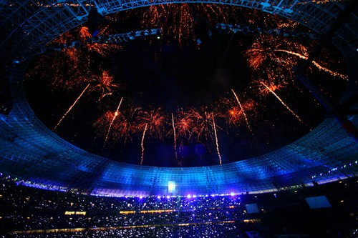
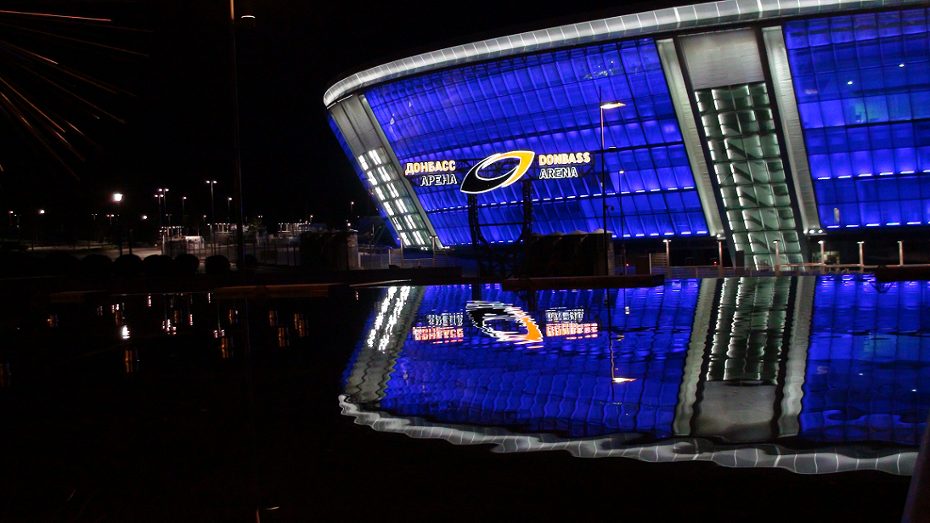
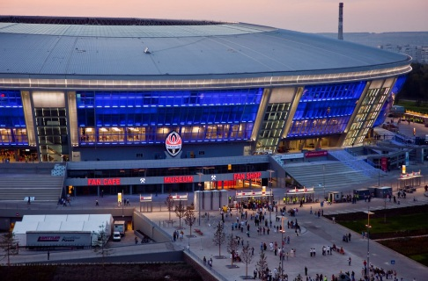
Projects
Sport Complexes
Donbass Arena, Shakhtar Donetsk Stadium
Stadium with 14.283 m² illuminated facade has 52.504 seating capacity

Slide 29
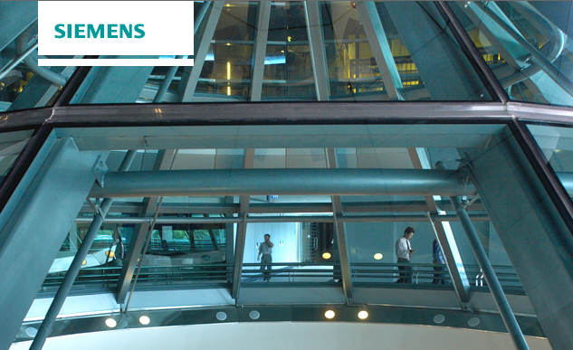
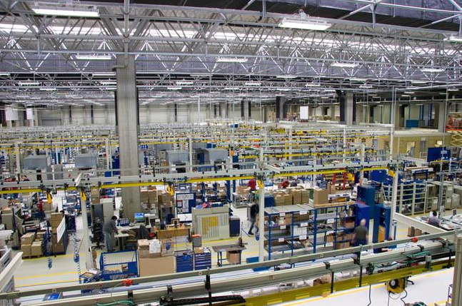
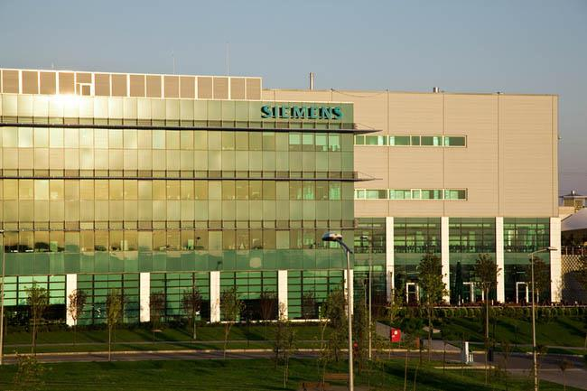
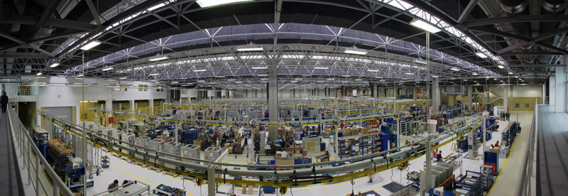
Projects
Industry
Siemens Gebze Plant, Green Building
Stadium with 14.283 m² illuminated facade has 52.504 seating capacity

Slide 30























References
Industrial

Slide 31






















References
Automotive & Aviation
Stadium with 14.283 m² illuminated facade has 52.504 seating capacity

Slide 32














References
Food & Beverage

Slide 33















References
Logistics

Slide 34












References
Fashion and Stores

Slide 35














References
Retail

Slide 36











References
Cultural / Historical Buildings

Slide 37









References
Big Building

Slide 38
References
NO | PROJECT NAME | COUNTRY | YEAR
1 | TÜTÜN ZAVODU | AZERBAIJAN | 2017
2 | ATEF YÜKSEK VOLTAJLI EKIPM. FAB. | AZERBAIJAN | 2017
3 | MINGECEVIR İPLIK FABRIKASI | AZERBAIJAN | 2017-2018
4 | KNIGHTSBRIDGE COURTYARD 6 PROJESI | AZERBAIJAN | 2018
5 | PROCLAD FACTORY | BAE | 2016
6 | ACTION INTERNATIONAL SERVICES | BAE | 2016
7 | MARINA GATE 1 | BAE | 2017-2018
8 | ROYAL MIRAGE | BAE | 2017
9 | GULF FOOR INDUSTRIES | BAE | 2017
10 | DSC FACILITIES SERVICES | BAE | 2017
11 | WAAGNER BIRO | BAE | 2017
12 | AL GHURAIR CENTER | BAE | 2017
13 | HATIL PROJECT | BANGLADESH | 2017
14 | PATRIOT ECO APPARELS LTD. | BANGLADESH | 2017
15 | BACHA KHAN INTERNATIONAL AIRPORT | PAKISTAN | 2018
16 | CITY TOWER | BULGARIA | 2016
17 | VIVAPLAST PLOVDIV | BULGARIA | 2016
18 | ALCOMET | BULGARIA | 2016-2018
19 | LEOPOLD DJORDAN | BULGARIA | 2016
NO | PROJECT NAME | COUNTRY | YEAR
20 | MARTINELI | BULGARIA | 2016
21 | VENKOV ENGINEERING | BULGARIA | 2016
22 | 5MBAL SOFIA HOSPITAL | BULGARIA | 2016
23 | SE BORNETZE | BULGARIA | 2016
24 | EFBET | BULGARIA | 2016
25 | NEKSAS LTD | BULGARIA | 2017
26 | ABB PLOVDIV | BULGARIA | 2017-2018
27 | ABB SEVLIEVO | BULGARIA | 2017
28 | ELEKTRA | BULGARIA | 2017-2018
29 | ELEKTRA BURGAZ BELEDİYESİ | BULGARIA | 2018
30 | WRITGEN STRABAG | BULGARIA | 2017
31 | TTL LTD | BULGARIA | 2017
32 | LINDNER VILLA KENT | BULGARIA | 2017
33 | LINDNER | BULGARIA | 2018
34 | TECHNOMATIX KAI | BULGARIA | 2017
35 | CAPITAL FORT | BULGARIA | 2017
36 | ENPAY SHUMEN | BULGARIA | 2017
37 | ELEKTRA BURGAZ | BULGARIA | 2017
38 | LINDNER RESIDENTAL PARK | BULGARIA | 2017
NO | PROJECT NAME | COUNTRY | YEAR
40 | MIKROELEKTRONIKA BOTEVGRAD | BULGARIA | 2017-2018
41 | TEKLAS BULGARISTAN | BULGARIA | 2017-2018
42 | TAL ENGINEERING | BULGARIA | 2018
43 | CDES SERVICES | BELGIUM | 2017
44 | LTH | CROATIA | 2016
45 | DJEČJI VRTIĆ PRELOG | CROATIA | 2017
46 | FLAME SPRAY | CROATIA | 2017
47 | PEWAG VAMBERK | CZECH REPUBLIC | 2017
48 | GESTAMP | CZECH REPUBLIC | 2017
49 | LISOVNA PLASTŮ VELKÉ MEZIŘÍČÍ | CZECH REPUBLIC | 2017
50 | RONAL JELZ | CZECH REPUBLIC | 2017
51 | TEPLICKA MOST SLOVAKIA | CZECH REPUBLIC | 2017
52 | G A C Z | CZECH REPUBLIC | 2017
53 | BRNO VETERINARY UNIVERSITY | CZECH REPUBLIC | 2017
54 | LIPLASTEC PROJECT LIBEREC | CZECH REPUBLIC | 2017-2018
55 | MASARYK UNIVERSITY BRNO | CZECH REPUBLIC | 2018
56 | SPORTS HALL JESENÍK | CZECH REPUBLIC | 2017-2018
57 | VETERINARY UNIVERSITY BRNO - OBJECT | CZECH REPUBLIC | 2017-2018

Slide 39
References
NO | PROJECT NAME | COUNTRY | YEAR
58 | PRAGUE FILM STUDIOS | CZECH REPUBLIC | 2018
59 | UNIPRES FACTORY BIRMINGHAM | ENGLAND | 2016
60 | UNIPRESS | ENGLAND | 2018
61 | TINBERGEN BUILDING OXFORD UNIVERSIT | ENGLAND | 2016
62 | LONDON DOCKS | ENGLAND | 2016
63 | FINANCE & STRATEGY OFFICE PROJECT | ENGLAND | 2016
64 | COSTCUTTER MARKET LONDON | ENGLAND | 2016
65 | LONDON DOCK PHASE 1 | ENGLAND | 2017
66 | HYPERSTAR AT NISHAT EMPORIUM MALL | PAKISTAN | 2016
67 | BRITISH COUNCIL LIBRARY | PAKISTAN | 2016
68 | WORLD BANK PROJECT | PAKISTAN | 2018
69 | UBL PACKAGE 2 | PAKISTAN | 2016
70 | PACKAGES MALL | PAKISTAN | 2016
71 | MARGALLA TELENOR | PAKISTAN | 2016
72 | NISHAT EMPORIUM | PAKISTAN | 2016
73 | HYPERSTAR AT LUCKY ONE TABBA MALL | PAKISTAN | 2016
74 | G4 BUILDING KARACHI OUTDOOR | PAKISTAN | 2016
NO | PROJECT NAME | COUNTRY | YEAR
75 | PACK MALL HYPERSTAR | PAKISTAN | 2016
76 | TELENOR HEAD OFFICE BUILDING | PAKISTAN | 2017
77 | UBL LAHORE | PAKISTAN | 2017-2018
78 | ISLAMABAD AIRPORT MOSQUE | PAKISTAN | 2018
79 | SHAHEEN AIRLINES AIRPORT HANGER PRO | PAKISTAN | 2017-2018
80 | ELVY DEPO | EGYPT | 2017
81 | SOORTY ENTERPRISES | PAKISTAN | 2017-2018
82 | ACHILL REPLACEMENT | FRANCE | 2016
83 | GOODMAN CARVIN | FRANCE | 2016
84 | VIGNAL PROJECT | FRANCE | 2016
85 | GERFLOR | FRANCE | 2016-2018
86 | ALAINE LA FAY AUX LOGES | FRANCE | 2017-2018
87 | NUMALIANCE | FRANCE | 2017-2018
88 | BIOCOOP NOVES | FRANCE | 2017-2018
89 | CSP COURNON | FRANCE | 2017-2018
90 | ENTREPOT COURNON | FRANCE | 2017
91 | AMAZONE BRETIGNY | FRANCE | 2017-2018
92 | EIC THEVENON PROJECT | FRANCE | 2017
93 | CHARVIN | FRANCE | 2017-2018
NO | PROJECT NAME | COUNTRY | YEAR
94 | BARJANE BELLEVILLE | FRANCE | 2017
95 | GYMNASE ST PAUL EN JAREZ | FRANCE | 2017
96 | SEGRO MITRY MORY | FRANCE | 2017
97 | LUINO | FRANCE | 2018
98 | AMAZONE GARONOR | FRANCE | 2017
99 | CSP PROJECT | FRANCE | 2017
100 | SETFORGE | FRANCE | 2017-2018
101 | IMEMONT | FRANCE | 2018
102 | GOODMAN ST MARD | FRANCE | 2017
103 | SUSIN | FRANCE | 2018
104 | PELANDRI | FRANCE | 2018
105 | NUMALIANCE | FRANCE | 2018
106 | TURRIN IMPIANTI | FRANCE | 2018
107 | SYSTEM IMPIANTI | FRANCE | 2018
108 | CAZZIN | FRANCE | 2018
109 | SALTI V2 | FRANCE | 2017
110 | LE COUDRAY MONTCEAUX BATC | FRANCE | 2018
111 | AMAZON | FRANCE | 2017

Slide 40
References
NO | PROJECT NAME | COUNTRY | YEAR
112 | AMAZON BURAGO | FRANCE | 2018
113 | ASP TECNOLOGIE | FRANCE | 2018
114 | PORTO CERESIO | FRANCE | 2018
115 | ELEKTRIS | FRANCE | 2018
116 | R.E.M. RAVASIO BOLOGNA | FRANCE | 2018
117 | IC AUTOMATION | FRANCE | 2018
118 | AUTONORD | FRANCE | 2018
119 | FABO | FRANCE | 2018
120 | GLD PROJECT | FRANCE | 2017
121 | JUMPERS FITNESS 700033 | GERMANY | 2016
122 | HAMBURG | GERMANY | 2016
123 | EHRINGER STR | GERMANY | 2016
124 | TKS HOFFSCHE | GERMANY | 2016
125 | TKS KRB | GERMANY | 2016
126 | DUISBURG TKS E-SHOP | GERMANY | 2016
127 | DUISBURG THYSSENKRUPP HOFFS | GERMANY | 2016
128 | LAGER | GERMANY | 2016
129 | TECHLAY KIRCHMAN | GERMANY | 2016
130 | RAKER 700061 | GERMANY | 2017
NO | PROJECT NAME | COUNTRY | YEAR
131 | CARREFOUR HYPERMARKET GLDANI | GEORGIA | 2016
132 | AXIS CARREFOUR | GEORGIA | 2016
133 | GALLERIA MALL | GEORGIA | 2017
134 | TEST HANGAR | GEORGIA | 2017
135 | NOVA HELLAS PROJECT | GREECE | 2016
136 | GEORGE BANINI RESIDENTIAL PROPERTY | GHANA | 2017
137 | CHEMARK | HUNGARY | 2016
138 | RPP WAREHOUSE, PELLÉRD | HUNGARY | 2018
139 | KRESZ&FIEDLER, PÉCSVÁRAD | HUNGARY | 2017-2018
140 | WAREHOUSE, PELLÉRD | HUNGARY | 2017
141 | MILE | HUNGARY | 2017
142 | SPAR CONVINENCE | HUNGARY | 2017
143 | MEDITERRAN, BOLY | HUNGARY | 2017
144 | KONTAKT ELEKTRO | HUNGARY | 2017
145 | DUNA-DRÁVA CEMENT | HUNGARY | 2017
146 | DANIELLA LTD | HUNGARY | 2017
147 | TECHNIQ OFFICE BUILDING | HUNGARY | 2017
148 | MEDITERRÁN, BÓLY | HUNGARY | 2017
NO | PROJECT NAME | COUNTRY | YEAR
149 | POLICE STATION, MOHÁCS | HUNGARY | 2017
150 | CONT | HUNGARY | 2017
151 | MILE WAREHOUSE | HUNGARY | 2017
152 | BUD AIRPORT | HUNGARY | 2017
153 | ALKOLOID | HUNGARY | 2018
154 | OMS QUARK | HUNGARY | 2017
155 | COOP EXTRA | HUNGARY | 2017
156 | PELLEGRINI SPA | ITALIA | 2010
157 | CPL TORVERGATA UNIVERSITY | ITALIA | 2018
158 | MARCEGAGLIA CHINA | ITALIA | 2010
159 | BORMIOLI | ITALIA | 2013-2014
160 | SAIMA AVANDERO | ITALIA | 2014
161 | GAZELEY | ITALIA | 2014
162 | AGENZIA DELLE DOGANE | ITALIA | 2014
163 | STEFANELLI SITE IVECO | ITALIA | 2015
164 | DUFERDOFIN | ITALIA | 2015
165 | DE LONGHI | ITALIA | 2015-2018
166 | EUROSET | ITALIA | 2015

Slide 41
References
NO | PROJECT NAME | COUNTRY | YEAR
167 | VENEZIA HELICOPTER HANGAR | ITALIA | 2015
168 | CEVA STRADELLA | ITALIA | 2015
169 | COLOR SYSTEM | ITALIA | 2015
170 | MARCEGAGLIA POZZOLO FORMIGARO | ITALIA | 2015
171 | FIAT SEVEL ATESSA | ITALIA | 2016
172 | DECATHLON BRANDIZZO | ITALIA | 2016
173 | GABRIELLI | ITALIA | 2016
174 | TELECOM REISS ROMOLI | ITALIA | 2016
175 | FERRERO | ITALIA | 2016
176 | AXA INSURANCE | ITALIA | 2016
177 | NATURA SI | ITALIA | 2016
178 | MARIO RONCHI | ITALIA | 2016
179 | LAVENO STATION | ITALIA | 2016
180 | BISOL | ITALIA | 2016
181 | VINORTE | ITALIA | 2016
182 | MAXI D LOGISTICS BELFIORE | ITALIA | 2016
183 | MAXI D LOGISTICS SAN SEPOLCRO | ITALIA | 2016
184 | COCA COLA MARCIANISE | ITALIA | 2016
185 | MALVESTIO | ITALIA | 2016
NO | PROJECT NAME | COUNTRY | YEAR
186 | CARBONERA | ITALIA | 2016
187 | SPINELLI | ITALIA | 2016
188 | BASSO IMPIANTI | ITALIA | 2016
189 | OLDRATI | ITALIA | 2016
190 | CROAZIA LOGISTIC | ITALIA | 2017
191 | CARCANO LOGISTIC | ITALIA | 2017
192 | FEDRIGONI_INTEGRATION | ITALIA | 2017
193 | FEDRIGONI | ITALIA | 2018
194 | FERPLANT | ITALIA | 2017
195 | LUINO STATION | ITALIA | 2017
196 | GTT TORINO | ITALIA | 2017
197 | GUCCI WAREHOUSE & OFFICE | ITALIA | 2017
198 | G&B STUDIOS | ITALIA | 2018
199 | SIGIT LACEDONIA | ITALIA | 2017
200 | CEVA LAZZATE | ITALIA | 2017
201 | EON | ITALIA | 2017
202 | MONDINI | ITALIA | 2017
203 | ORIGGIO LOGISTIC | ITALIA | 2017
204 | ATM VILLA FIORITA | ITALIA | 2017
NO | PROJECT NAME | COUNTRY | YEAR
205 | CARMEX PRECISION TOOLS | ISRAEL | 2016
206 | AMIT SYSTEM | ISRAEL | 2017
207 | DGANIR | ISRAEL | 2017
208 | BLOOMFIELD STADIUM | ISRAEL | 2017
209 | AVIS LOGISTICS CENTRE | ISRAEL | 2017-2018
210 | FAMFA OIL LTD LAGOS | ISRAEL | 2018
211 | ROAD 6 | ISRAEL | 2018
212 | SHEAN KOR | ISRAEL | 2017
213 | JTI SUDAN | JORDAN | 2016
214 | AIR FORCE ENGINEERING PART TWO | JORDAN | 2017
215 | MINISTRY COMPLEX | KUWAIT | 2016
216 | AUM EXTENSION BUILDING | KUWAIT | 2016
217 | KUWAIT INTERN. AIRPORT SUPPORT TERMINAL | KUWAIT | 2017-2018
218 | AL ARGAN OFFICE-GTRC | KUWAIT | 2018
219 | ALGHANIM | KUWAIT | 2017
220 | INJAZ OFFICE | KUWAIT | 2018
221 | XCITE KSA 5,6,7 | KUWAIT | 2018
222 | WENDYS DUBAI MALL | KUWAIT | 2018

Slide 42
References
NO | PROJECT NAME | COUNTRY | YEAR
223 | WENDYS | KUWAIT | 2017
224 | WENDYS_QATAR | KUWAIT | 2018
225 | AL HUSSAIN FACTORY | LIBYA | 2016
226 | OYA METALS CO | LIBYA | 2016
227 | CAP-CON / KSS PLANT | MACEDONIA | 2015
228 | SEMAC TEXTILE PLANT | MACEDONIA | 2016
229 | VAN HOOL PHASE 1 | MACEDONIA | 2016
230 | ALKALOID PHARMACEUTICAL COMPANY | MACEDONIA | 2016
231 | CEMENT FACTORY "TITAN" | MACEDONIA | 2016
232 | JOHNSON CONTROL | MACEDONIA | 2017
233 | WIK 1 PRILEP | MACEDONIA | 2017
234 | WIK HALL | MACEDONIA | 2018
235 | AKTIVA AUTOMOTIVE | MACEDONIA | 2017
236 | OIL COMPANY PRILEP | MACEDONIA | 2017
237 | VAN HOOL PHASE 2-3 | MACEDONIA | 2017
238 | NEW SQUARE IN SKOPJE | MACEDONIA | 2017
239 | ELECTRICAL FACULTY | MACEDONIA | 2018
240 | PRODUCTION HALL OF AKTIVA & WIK | MACEDONIA | 2018
241 | ITHAAFUSHI RESORT | MALDIVES | 2017-2018
NO | PROJECT NAME | COUNTRY | YEAR
242 | TOTAL MAURITIUS FLACQ FUEL STATION | MAURITUS | 2016
243 | INTERMART EBENE MRU | MAURITUS | 2017
244 | ANZ COVE TRIANGLE CENTRE | NEW ZEALAND | 2016
245 | CIALPOST WAREHOUSE | NEW ZEALAND | 2016
246 | GRAHAM CONDON CENTRE | NEW ZEALAND | 2016
247 | PIONEER HALL | NEW ZEALAND | 2016
248 | ST ALBANS SCHOOL | NEW ZEALAND | 2016
249 | HORNY PR.SCHOOL | NEW ZEALAND | 2016
250 | MANGERE WASTEWATER | NEW ZEALAND | 2016
251 | MOJ JUSTICE EMERGENCY SERVICES PRECINCT | NEW ZEALAND | 2017
252 | WHENUAPAI HANGAR 4 | NEW ZEALAND | 2017
253 | AERIX GROUP | NIGERIA | 2017
254 | MECAFOR-LABORATORY | SERBIA | 2016
255 | MECAFOR PROJECT | SERBIA | 2016
256 | ALEX CO- FILTERS PRODUCTION | SERBIA | 2017
257 | KIKINDA - SERBIA | SERBIA | 2018
258 | TEKLAS SERBIA | SERBIA | 2017
259 | NURSE ACCOMMODATION | SAUDI ARABIA | 2016
NO | PROJECT NAME | COUNTRY | YEAR
260 | RAZI PHARMA SIPARIŞI | SAUDI ARABIA | 2016
261 | AL JABR VILLAS PROJECT | SAUDI ARABIA | 2016
262 | MA'ADEN PROJECT | SAUDI ARABIA | 2016
263 | HARBOUR ROTTERDAM | SWEDISH | 2016
264 | HAMBURG HARBOUR | SWEDISH | 2017
265 | SKI PARK | SWEDISH | 2017
266 | AL RIFFA METRO PROJECT | QATAR | 2016
267 | WAKRA VILLA PROJECT | QATAR | 2016
268 | QUE STORE | QATAR | 2016
269 | YAMAMAY | QATAR | 2016
270 | VIRTUS | QATAR | 2016
271 | AURO OFFICE | QATAR | 2016
272 | DINNER STATION | QATAR | 2016
273 | RIVERA MAISON & BALADNA | QATAR | 2016
274 | EDUCATION CITY METRO PROJECT | QATAR | 2017-2018
275 | HAMAD İNTERNATIONAL AIRPORT STATION | QATAR | 2017-2018
276 | UNDERGROUND PROJECT PACKAGE 1 | QATAR | 2017-2018
277 | UNDERGROUND PROJECT PACKAGE 2 | QATAR | 2017
278 | UNDERGROUND PROJECT PACKAGE 3 | QATAR | 2017

Slide 43
References
NO | PROJECT NAME | COUNTRY | YEAR
279 | MILAHA LOGISTICS AND WAREHOUSE | QATAR | 2017
280 | EXTINDERE | ROMANIA | 2016
281 | GREINER ASSISTEC | ROMANIA | 2016
282 | NIMET | ROMANIA | 2016
283 | MARTUR LT | ROMANIA | 2016
284 | ETI CRAIOVA | ROMANIA | 2016
285 | ELECTRO GRUP | ROMANIA | 2017
286 | MICHELIN ZALAU | ROMANIA | 2017-2018
287 | EXT DESLEE RM VALCEA | ROMANIA | 2017
288 | CARREFOUR WDP STE | ROMANIA | 2017-2018
289 | ELECTRIC GROUP | ROMANIA | 2017
290 | SEDO | ROMANIA | 2017
291 | EXT WDP RM VALCEA | ROMANIA | 2017
292 | MINET RM VALCEA | ROMANIA | 2018
293 | TIAB | ROMANIA | 2017
294 | KASTAMONU ENTEGRE FACTORY | ROMANIA | 2018
295 | YILDIZ ENTEGRE-ROMANYA MDF | ROMANIA | 2017
296 | MERCEDES BENZ RUSYA | RUSSIA | 2017
297 | PORCELANOSA – VILA REAL 1ST PHASE | SPAIN | 2016
NO | PROJECT NAME | COUNTRY | YEAR
298 | PORCELANOSA VENIS | SPAIN | 2018
299 | ZSCHIMMER SCHWARZ | SPAIN | 2016
300 | ECOAUT | SPAIN | 2016
301 | PORCELANOSA – GLASGOW AMPL | SPAIN | 2016
302 | ENEACER | SPAIN | 2016
303 | IBERO IN SPAIN | SPAIN | 2016
304 | TÚNEL VENIS | SPAIN | 2016
305 | PORCELANOSA – NOKEN | SPAIN | 2016
306 | MARTI | SPAIN | 2016
307 | COMPACGLASS | SPAIN | 2016
308 | GARENERSAVING - IBERO | SPAIN | 2016
309 | CERAMICA GOMEZ | SPAIN | 2017
310 | GAMADECOR | SPAIN | 2017
311 | BOMBAS DOLZ | SPAIN | 2017
312 | KV PROJECT | SPAIN | 2017
313 | IVECO | SPAIN | 2018
314 | PORCELANOSA | SPAIN | 2017
315 | VENIS | SPAIN | 2017
NO | PROJECT NAME | COUNTRY | YEAR
316 | JC WAREHOUSE | SPAIN | 2018
317 | POWER ELECTRONICS | SPAIN | 2018
318 | TÜRKMENISTAN SEAPORT LIMAN | TURKMENISTAN | 2017-2018
319 | TÜRKMENİSTAN DAĞLIGRUP | TURKMENISTAN | 2017
320 | DNIPRO WAREHOUSE | UKRAINE | 2017-2018
321 | ADOPEN | IRAN | 2018

Slide 44
REFERENCE LETTERS

Slide 45
REFERENCE LETTERS

Slide 46
CONTACTS
EAE Aydınlatma A.Ş.
Ikitelli Organize Sanayi Bolgesi
Eski Turgut Ozal Caddesi No:20
Basaksehir / ISTANBUL - TURKIYE
Tel : +90 212 413 21 00 (pbx)
Fax : +90 212 549 37 90
aydexport@eae.com.tr
www.eaeaydinlatma.com.tr

